Slide 1
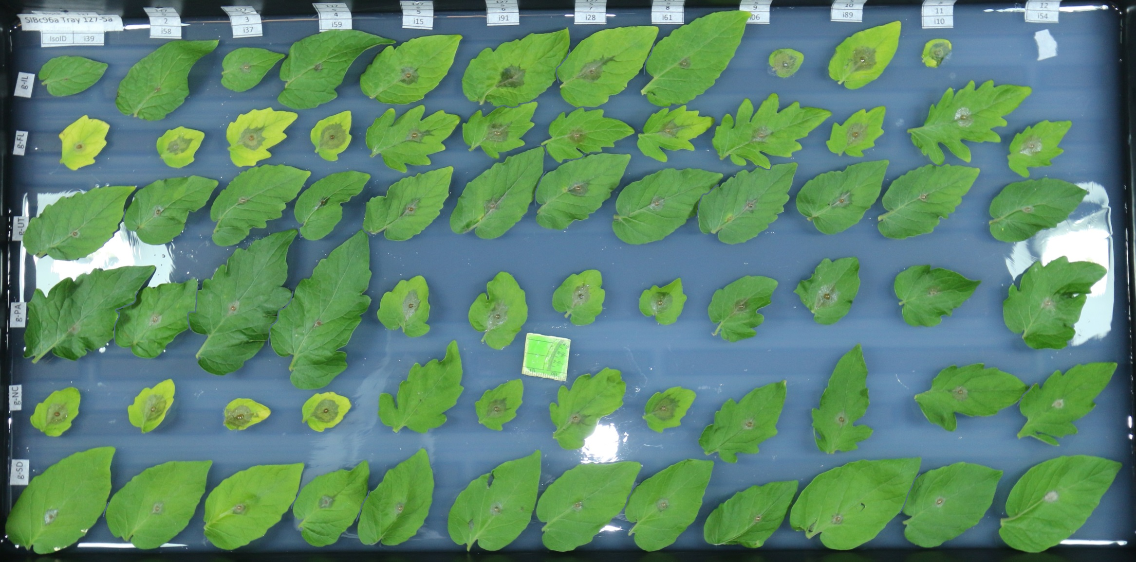
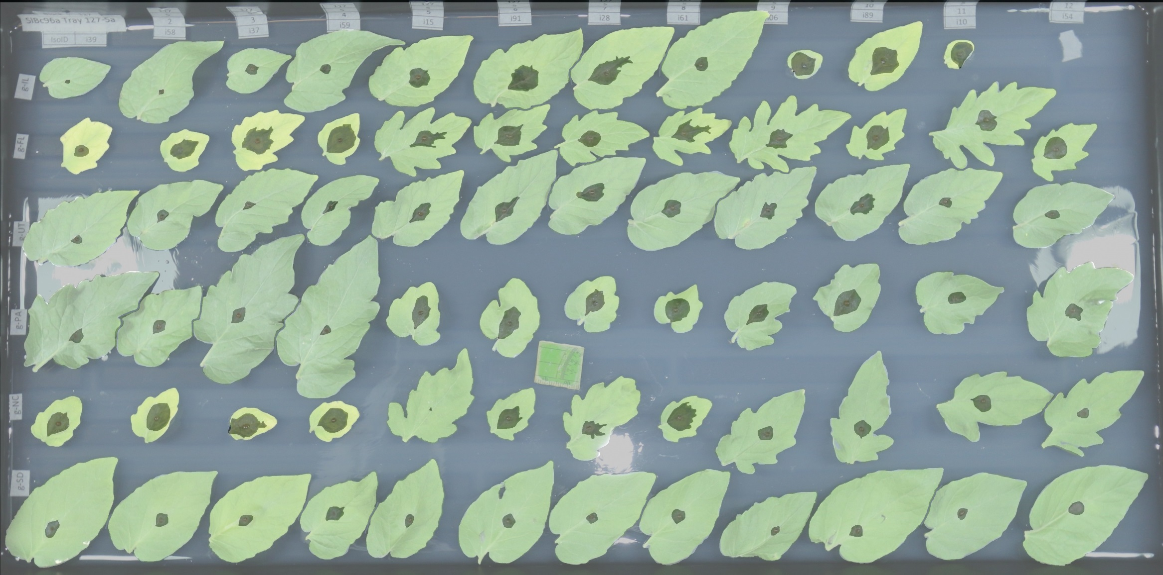
a
b
c
d
e
f
g
h

Slide 2
Figure 1. Botrytis cinerea x tomato diversity in detached leaf assay and digital image analysis. a) Individual tomato leaflets of 6 S. lycopersicum genotypes and 6 S. pimpinellifolium genotypes are in randomized rows, spore droplets of individual B. cinerea isolates are in randomized columns. Digital images are collected 72 hours post inoculation. Single droplets of 40 B. cinerea spores are infected on randomized leaflets using randomized isolates, and digital images are taken 72 hours post inoculation.
b) Digital masking of leaf and lesion is followed by automated measurement of area for each lesion.
c-h) Variation in lesion size resulting of the interaction of B. cinerea and diverse tomato genotypes.
c) Average lesion size of single B. cinerea isolates (line traces) across tomato host genotypes grouped by domestication status.
d) Highlight of the common reference B. cinerea isolate B05.10.
e) Highlight of the ten highest-virulence isolates, as estimated by mean virulence across all tomato genotypes.
f) Highlight of the ten most saprophytic, or low virulence, isolates, as estimated by mean virulence across all genotypes.
g) Highlight of the five isolates collected from tomato tissue.
h) Highlight of the two isolates with significant domestication sensitivity.

